Slide 1







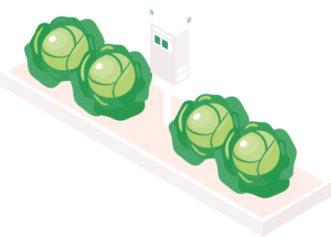
Startup Ideas
DolphinGroup
Proposal

Slide 2






Personnel
Dang Loc Project Manager
Phuoc Tung Tech Lead
Quoc Tuan Developer
Vi Khang Developer
Thu Huong Marketing, Business planner
Vi Triet Product Designer

Slide 3
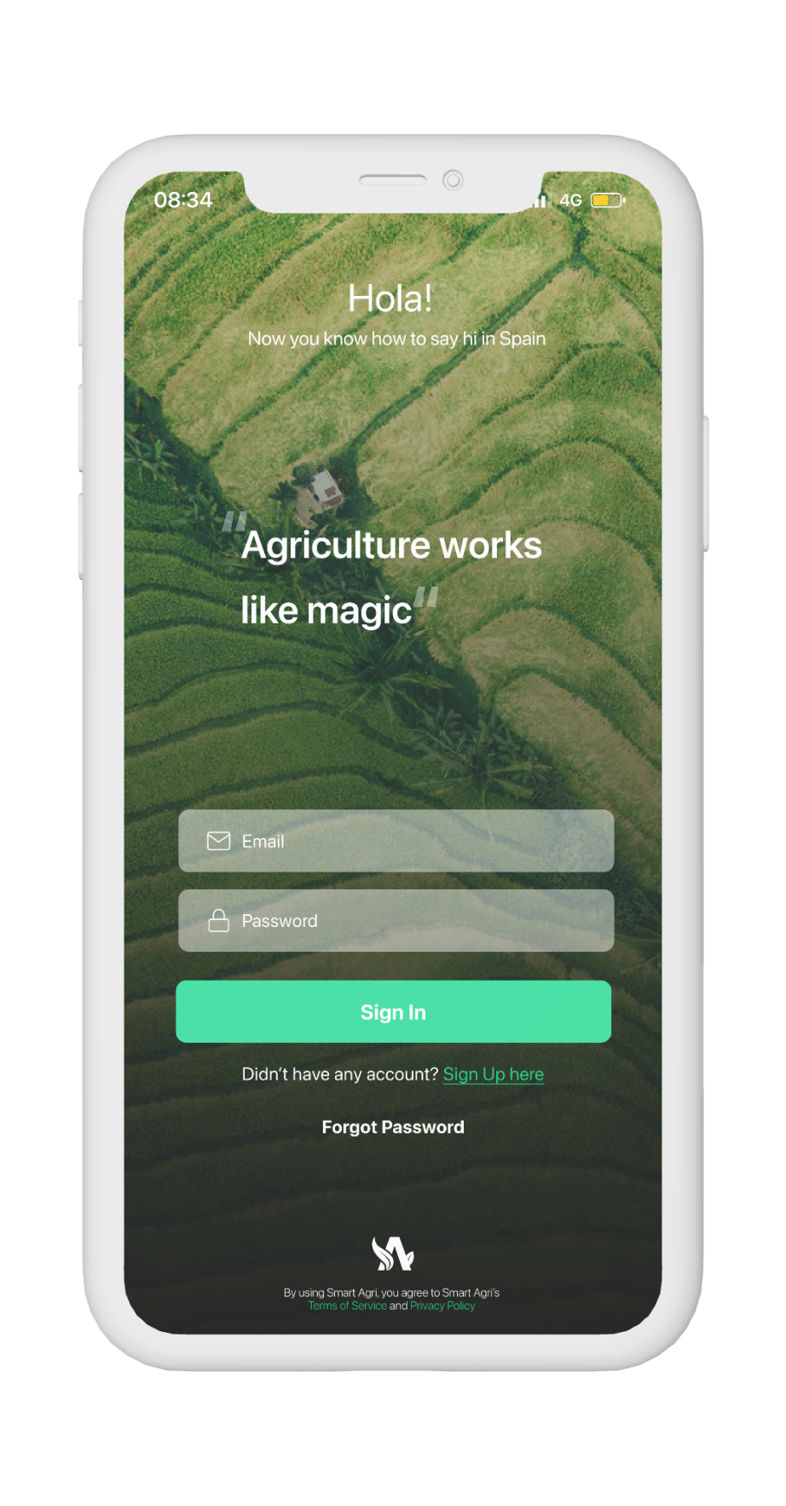

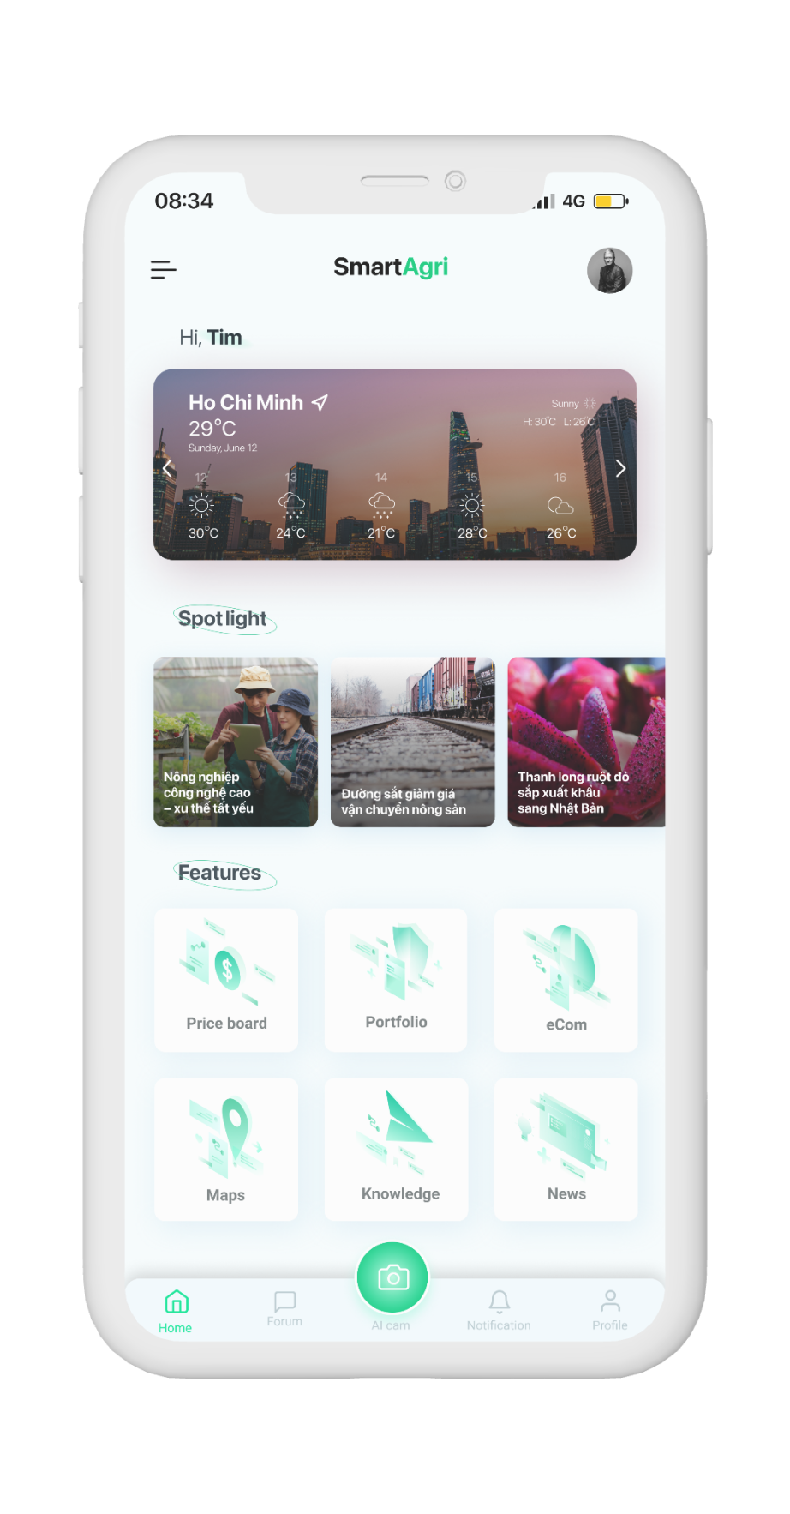
#1 SmartAgri
Target audience
Farmer (seller) and Buyer
Investor
Distributor
Age: Gen X – Gen Z
Hobbies: Agriculture, Investment
Problem
Demand for quality organic food is increasing
Limited distribution output of farms
Weak interconnection of agribusiness
Lack of high technology applications
Solution
Build a hybrid-app can:
+ Connects parties in Agribusiness
+ Browse and buy food from farm
+ View aggregated information of farms
+ Find investors, distributors, tourists and buyers
+ Update high-tech agricultural news
Highlights
Investment feature
E-com service
Sharing knowledge forum

Slide 4
#2 ProductZone
Target audience
Product Maker
Founder
Investor
Mentor
Age: Gen X – Gen Y
Context
Builders, innovators or SMEs have a change-making technology idea
Desire to share works to promote, get feedback
Find partners or mentors for a project
Investors find new ideas with development potential
Search from many different sources
Solution
Create a platform that:
+ Allow everyone to share and discover new products/ideas
+ Promote innovation and creativity
+ Includes a comment/voting system
+ Outstanding ideas will be featured
+ Startup find angel investors
+ Founder find teammates
Webflow
Notion
Framer

Slide 5
#3 School management system
Target audience
Students, Parents, Teachers
Problem
Many materials on schools: exams, timetable, syllabus or documents
Hard to keep track on all classes materials
Teachers are only able to communicate with students on classes
Parents don’t have many methods to access to children’s academic progress
Solution
All school activities will be in one place with an app
Student:
+ Checking timetable easily
+ Quick and easy assignment management
+ Get notified whenever there are changes in schedules
Teachers:
+ Access to lecture planning, materials and assignments
+ Online assessment results and progress
Parents:
+ Access to child’s academic progress and attendance data
+ Active participation in school activities
+ Updates on school events, holidays, and processes

Slide 6
#4 Learning & Document reading tool
Target audience
High school or university student
Office worker
Learner
Age: Gen X – Gen Y
Context
Many documents are in the form of digital asset
Read lots of separate resources
Notes are stored distributedly, not organized
Learning through practicle news/journal articles
Demand to take note when learn a new word or structure
Solution
A cross-platform app that:
+ Be able to read a ebook file
+ Organize the notes systematically and synchronized
+ Connect to other tools like Notion
+ Help user quickly learn new vocabs/structures in the articles
+ Put the vocab into a personal dictionary, or a flash card for further revision

Slide 7

#5 CarTrading
Target audience
Buyer: who is seeking for a car with high quality and reasonable price
Dealer: Who want to sell cars, especially old cars
Context
For buyer:
+ Not have useful review
+ doubt about the service, price of a car
+ Can’t offer for a best price during a short meeting when coming to a showroom
For dealer:
+ People might not know who the dealer are
+ Some legwork will be done automatically by the site
Solution
Build a system that:
+ Automate the process of buying include messaging, purchasing or dealing
+ Include used car inspection, valuation, auction and logistics services
+ Profide financial and operational tools that allow dealers to manage stores

Slide 8

THANK YOU!
If you have any questions?
Don’t hesitate to ask us
or contact us
dolphin.team111@gmail.com
DolphinGroup

